Slide 1

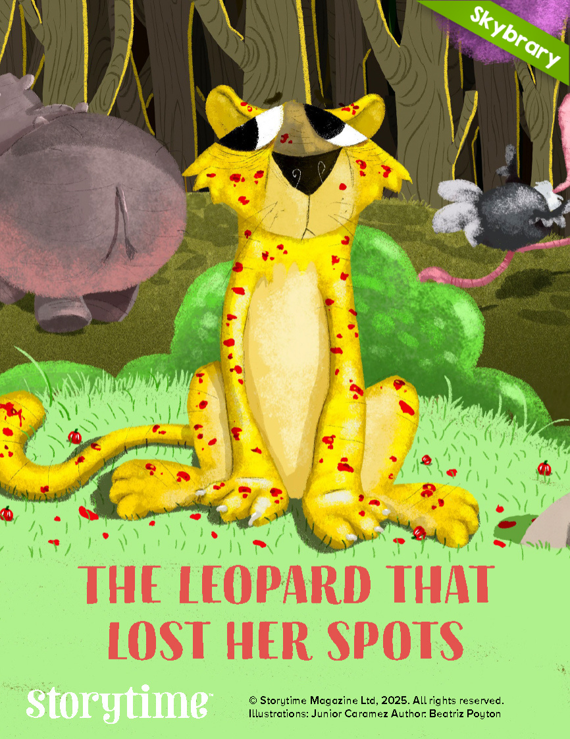
Read Aloud Guide for Families
The Leopard that Lost Her Spots
Author: Beatriz Poyton
Illustrator: Junior Caramez
Themes: Identity, Friendship, Acceptance
Book Brief: A heartfelt story about a leopard who loses her spots and must discover what truly makes her who she is, and what real friendship means!
READ ALOUD
Before Reading: Build Background
Ask, “What makes you who you are? If you changed how you looked, would you still be the same person inside?”
While Reading: Make Connections
What happens to the leopard during the race? How do her friends react?
How does the leopard feel when her friends don't recognize her? What does she try to do?
How does the leopard finally get her spots back? What do her friends learn?
After Reading: Ask Questions
Ask, "What lesson do the leopard and her friends learn about friendship and recognizing people for who they are inside?"
RELATED ACTIVITIES
If your child enjoyed this book:
Talk about "What Makes You, YOU!" Discuss the things that make your child special beyond how they look, like their personality, kindness, sense of humor, or talents. Create a "This Is Me" poster with drawings and words about what makes them unique, just like the leopard was still herself even without her spots.
Explore more free eBooks on Skybrary! Visit www.Skybrary.org to read more.
Family of Readers®
©2026 Reading Is Fundamental

